Slide 1
Thesis defense: An optimized circulating vector field obstacle avoidance guidance for unmanned aerial vehicles
Presented by: Garrett Clem
Advisor: Dr. Jay Wilhelm
Committee: Dr. Bob Williams, Dr. David Casbeer, Dr. Maarten Uijt de Haag
Notes:
Getting started
Refreshments available
Thank audience for attending, thanks to committee (Dr. Casbeer for traveling)
Introduction to fixed wings
Problem statement /objectives
Literature review – motivated the problem statement
Phases
Timeline
Questions

Slide 2
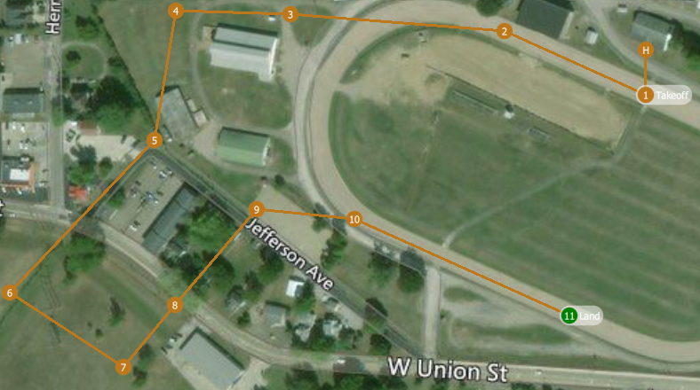
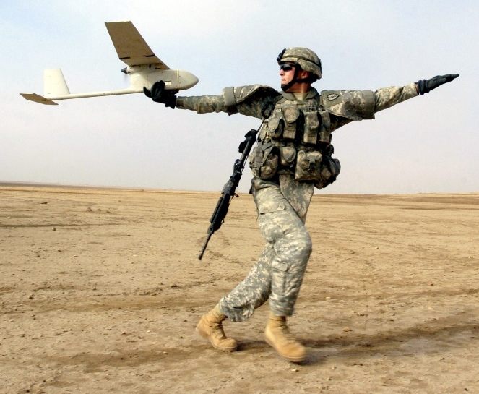
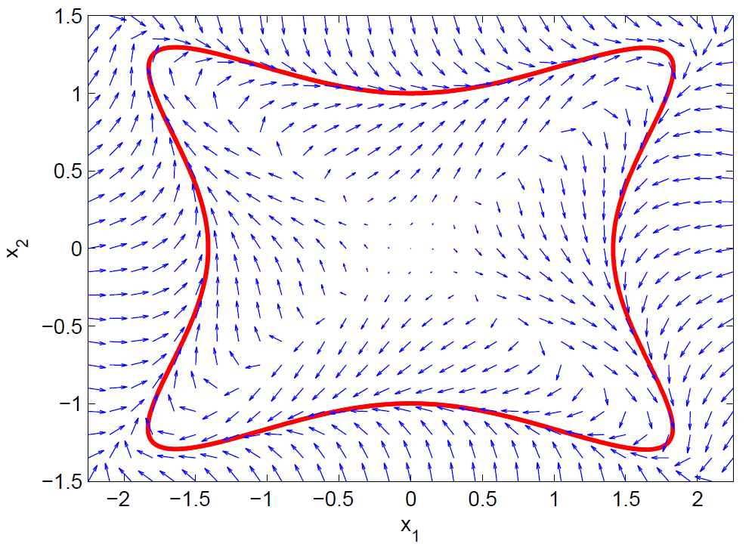
Introduction
Fixed Wing Unmanned Aerial Vehicles (UAVs)
Remotely piloted
On-board flight controller
Maintain stability
Carry out mission objectives
Follow waypoints or ground track
Waypoint navigation
Typically pre-planned at ground station
May consider known obstacles
Unknown obstacles may require waypoint re-planning
Sequential pre-planned waypoints
Hand-launched fixed wing UAV
Gradient vector field [ Goncalves, 2010]
Notes:
Fixed wing UAVs are a category of robotic aircraft
Remotely piloted with the assistance of an on-board autopilot
Autopilot maintains vehicle stability
Carry out mission objectives such as following waypoints
Waypoints are typically pre-planned before flight at a ground station
Obstacles such as buildings, mountains, and general no-fly zones may be considered during planning
During flight, unknown obstacles may be encountered which could require waypoints to be re-planned.
The UAV typically communicates with a ground station over radio to plan waypoints which may not always be possible
A possible solution is to use vector field guidance which combines path following with obstacle avoidance

Slide 3
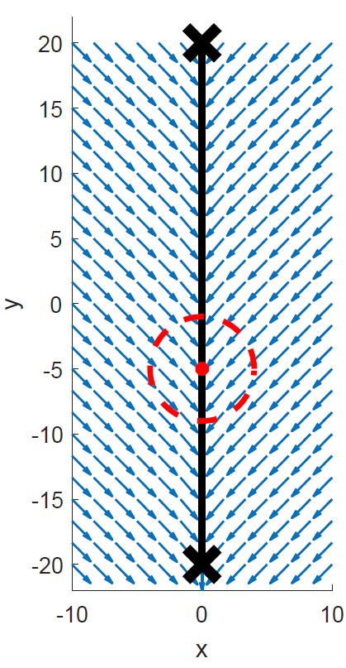
Problem Statement and Objectives
Problem Statement: Utilize vector field guidance to enable optimal obstacle avoidance without re-planning waypoints
Phase 1: Identify specific set of conditions that yield guidance singularity when summing attractive and repulsive GVFs
Phase 2: Determine GVF weighting functions that improve obstacle avoidance
Phase 3: Demonstrate GVF obstacle avoidance with crazyflie quadcopter under Dubin’s turn rate constraints
Straight path vector field guidance with obstacle
Notes:
Problem statement
Guidance between waypoints produced by an attractive vector field that has both circulation and convergence components
Obstacle along the path detected after planning can be represented as a repulsive field
Summing together fields can result in singularities
This will be achieved by completing three phases. (execution of three phases)
Phase 1: Description
Phase 2: Description
Phase 3: Description

Slide 4
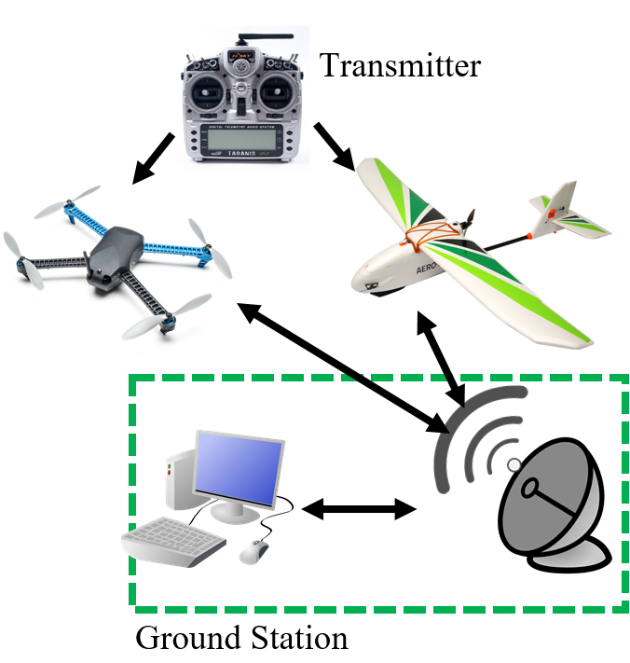
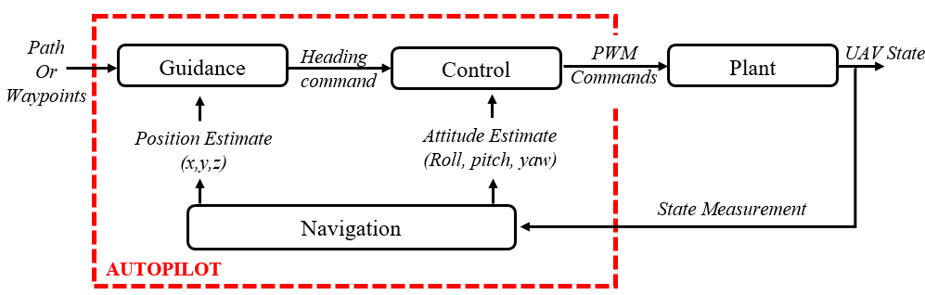
Literature Review
Unmanned Aerial System (UAS)
Aircraft
Fixed wing
Rotorcraft
Radio /Transmitter
Ground Station
Autopilot
Navigation
Guidance
Control
Notes:
UAVs are a part of a larger system called an Unmanned Aerial System which typically consists of four parts
The physical aircraft itself which typically can be categorized under one of two categories consisting of fixed wing and rotorcraft
Fixed wing UAVs typically have a larger payload and can fly long endurance missions compared to rotor craft
Rotor craft are more maneuverable and do not require a runway or launcher for deployment
Transmitters are used for direct UAV control and can be used short range
Radios can be used for long distance communication and for relaying sensor data back to a ground station
Ground stations are typically a PC equipped with software that sets vehicle parameters, collects data, and plans mission waypoints
Mission waypoints can be communicated back through the radio and sent to the autopilot which uses GNC systems to fly from waypoint to waypoint
Navigation consists of measuring the UAV state which is fed to G and C
Path, or waypoints, are fed to guidance which typically outputs a desired heading to the guidance system which actuates the UAVs controls to transition to the desired state
Guidance is where vector fields comes in

Slide 5
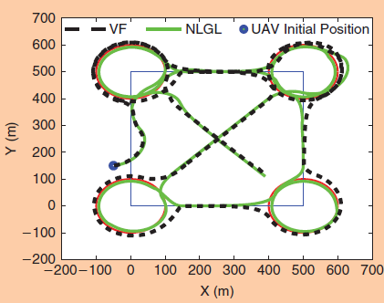
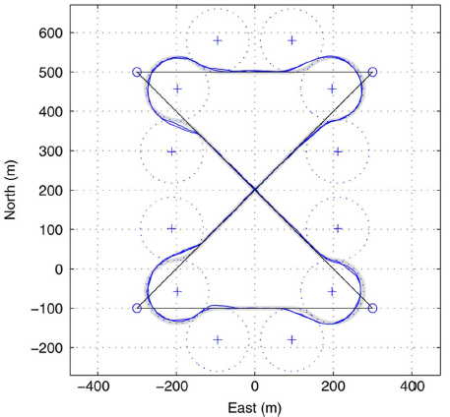
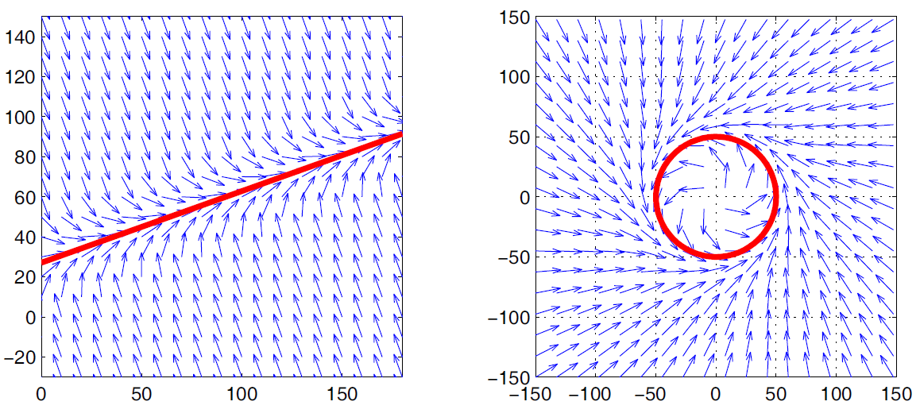
Literature Review
Guidance Methods
[Sujit, 2014]
Guidance provides heading reference commands
Waypoints, path following
Accurate and robust to disturbances
Vector field provided best performance
[Nelson, 2005]
Lyapunov vector field primitives
Asymptotically approach curve
Stitch paths together for complex behavior
UAV guidance along path via vector field [Sujit, 2014]
Switching primitives guidance for UAV [Nelson, 2005]
Lyapunov vector field path primitives [Nelson, 2005]
Notes:
Sujit et al presented a comparison between five common heading based guidance techniques (Carrot chasing, NLGL, PLOS, LQR, and Vector Field)
Guidance must be accurate (low error) and robust (rejects disturbances)
Guidance methods can fall under either waypoint or path following methods
Monty Carlo simulation of the five guidance techniques involving external wind disturbances determined that the path following vector field method had a low cross track error and was robust to external wind disturbances
Which is important for small fixed wing UAVs since winds can be expected to be 20-30% of the UAVs air speed
Nelson et al. demonstrated the construction of a lyapunov vector field for straight line a circular path primitives, which can be shown in the two figures at the bottom
The robustness of vector field is due to the converging nature of the field followed by circulation. Deviation from the path results in guidance back onto the path.
Nelson combined the use of straight line and circular primitives together to form more complex flight paths, shown in this figure
- The difficulty in using path primitives is the transition from one field to another

Slide 6
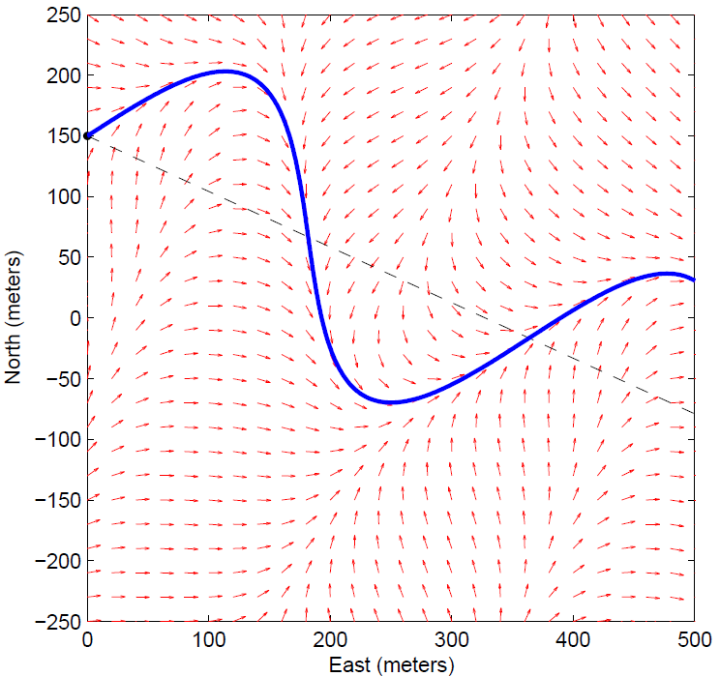
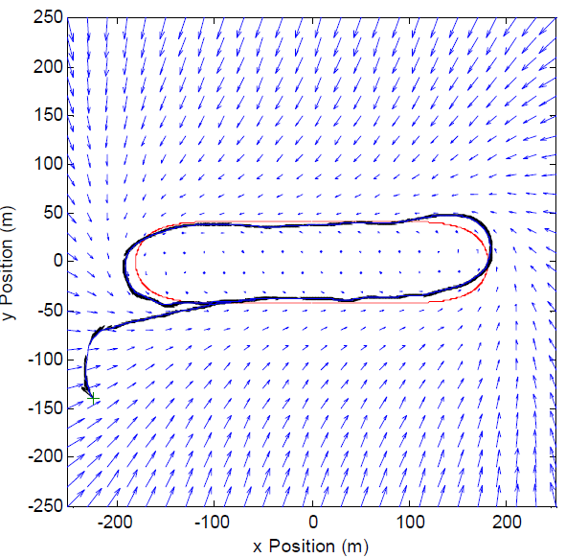
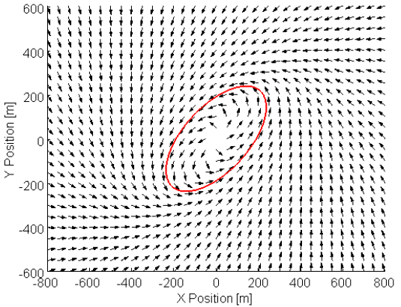
Literature Review
[Griffiths, 2006]
Expanded Nelson ‘s method for arbitrary paths
[Frew, 2007a]
Modify existing field
Non-linear coordinate transformation
[Frew, 2007b]
Modify field shape via position estimate covariance matrix
Standoff tracking uncertain targets
Lyapunov vector field guidance along curved path [Griffiths, 2006]
Non-linear coordinate transformation of stable circular Lyapunov vector field [Frew 2007]
Notes:
- Griffiths expanded on Neslon’s method and provided a lyapunov vector field for an arbitrary path, which is shown in the figure above
For closed paths, such as a loiter, Frew modified an existing circular field with non-linear coordinate transformation to produce a racetrack and elliptical pattern
Beneficial because fields already proven to converge
In the later paper, the vector field was used for tracking an uncertain target. The field was modified based on a kalman filters covariance matrix

Slide 7
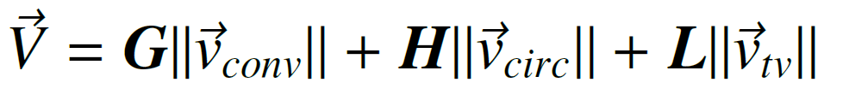
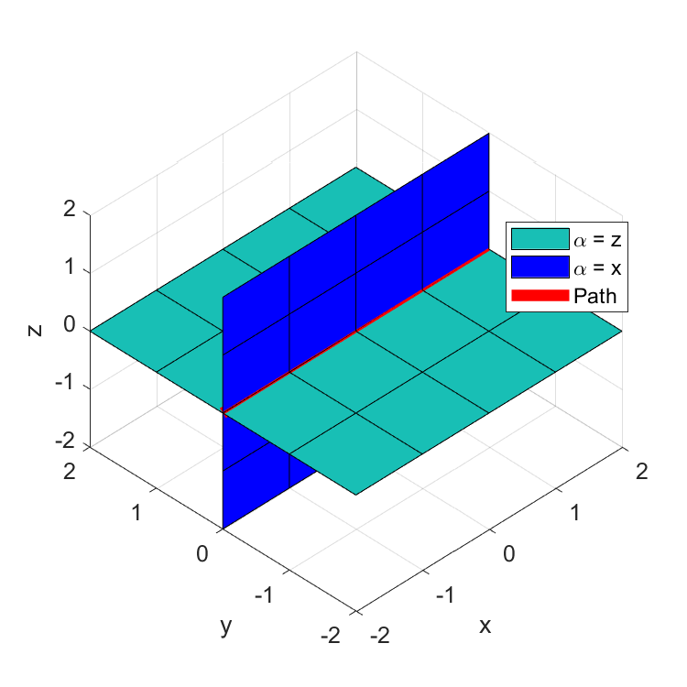
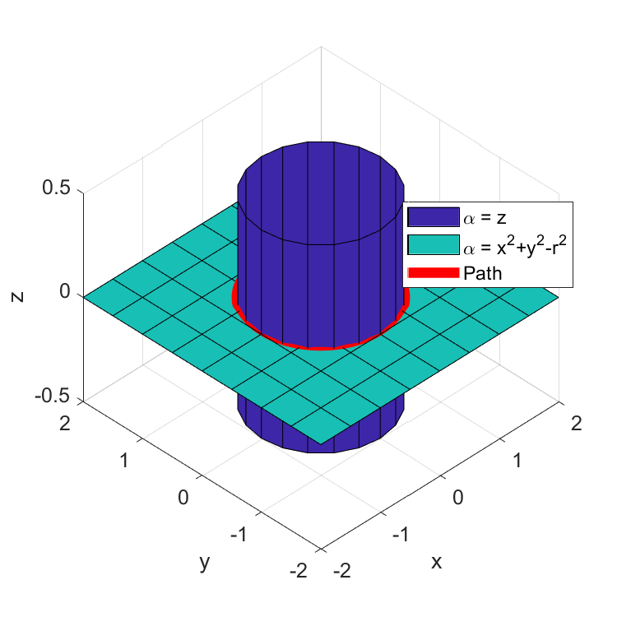
Literature Review
VF
Process
[Goncalves, 2009]
N-dimensional vector field
Converge and follows a path
Static
Time varying
Intersection of (n-1) surfaces
Surfaces defined by implicit functions
First order partials differentiable
Bounded second order partials
[Goncalves, 2010a]
Experimental validation (2d,3d robotic systems)
[Goncalves , 2010b]
Stability proofs of vector field
Straight path vector field converging at intersection of surfaces
VF
Process
Circular vector field converging at intersection of surfaces
Notes:
Goncalves et al presented a method for constructing an n-dimensional vector field that is guaranteed to converge and follow both static and time varying paths
Field circulate and converge at the intersection of (n-1) surfaces defined by implicit functions that must:
Have first order partials
Bounded second order partial derivatives
A vector field that converges and follows a straight line can be produced by intersecting two planes, shown above
And a vector field that converges and follows a circular path can be produced by intersecting a cylinder and a plane
Fields contain three components
Convergence
Circulation
Time varying
Other papers

Slide 8
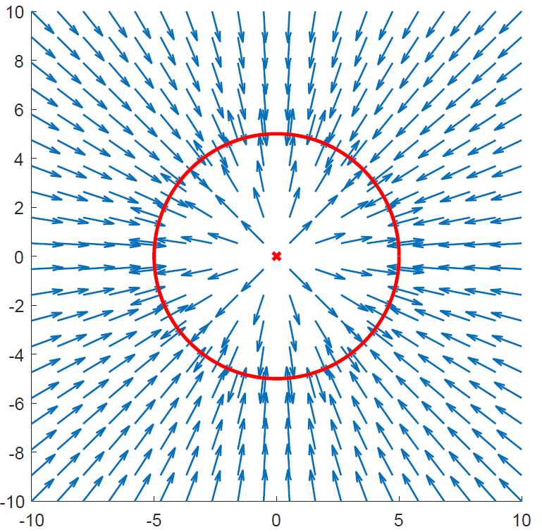
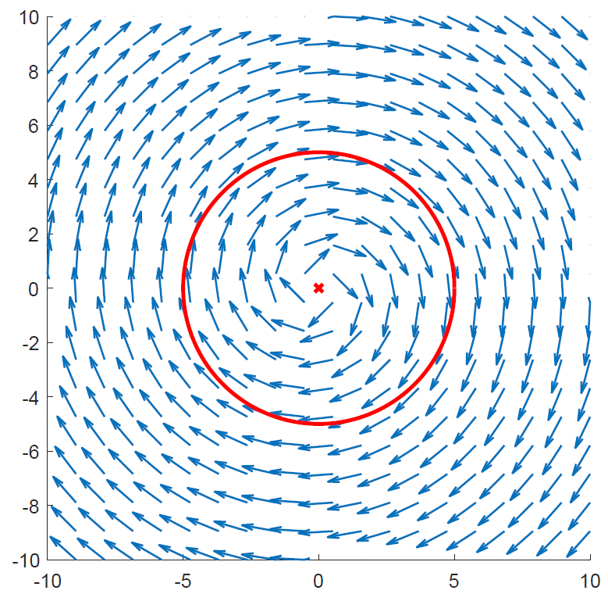
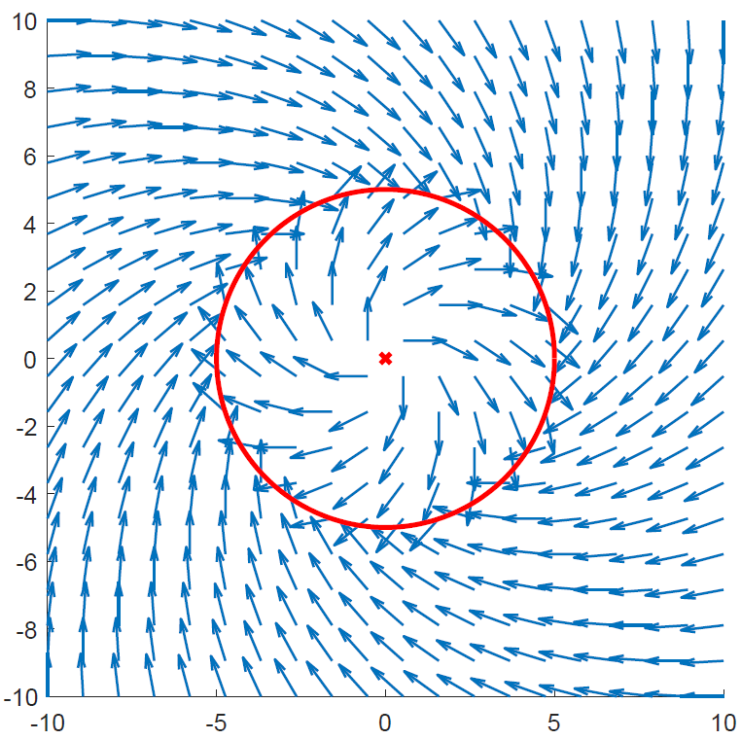
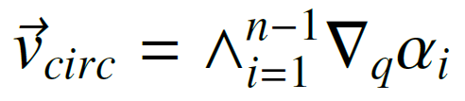
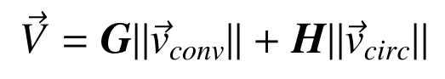
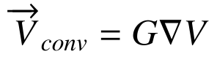
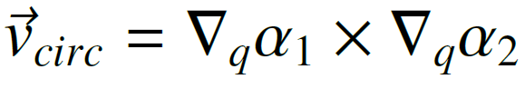
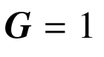
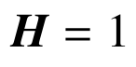
Literature Review
Normalized Convergence Normalized Circulation Total Field
Notes:
Goncalves et al presented a method for constructing an n-dimensional vector field that is guaranteed to converge and follow both static and time varying paths
Field circulate and converge at the intersection of (n-1) surfaces defined by implicit functions that must:
Have first order partials
Bounded second order partial derivatives
A vector field that converges and follows a straight line can be produced by intersecting two planes, shown above
And a vector field that converges and follows a circular path can be produced by intersecting a cylinder and a plane
Fields contain three components
Convergence
Circulation
Time varying
Other papers

Slide 9
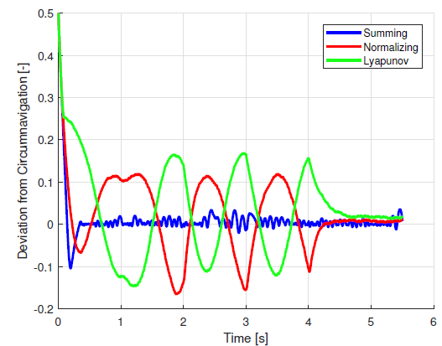
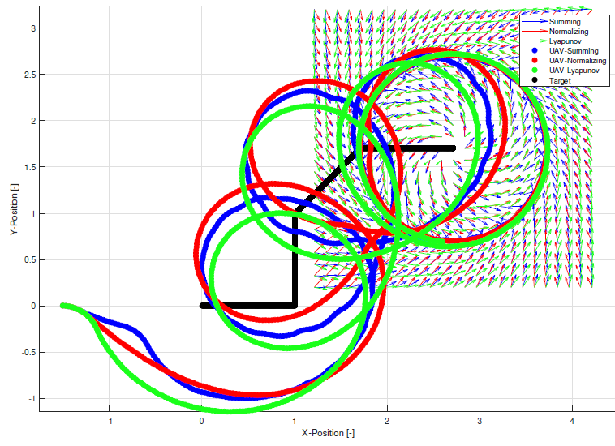
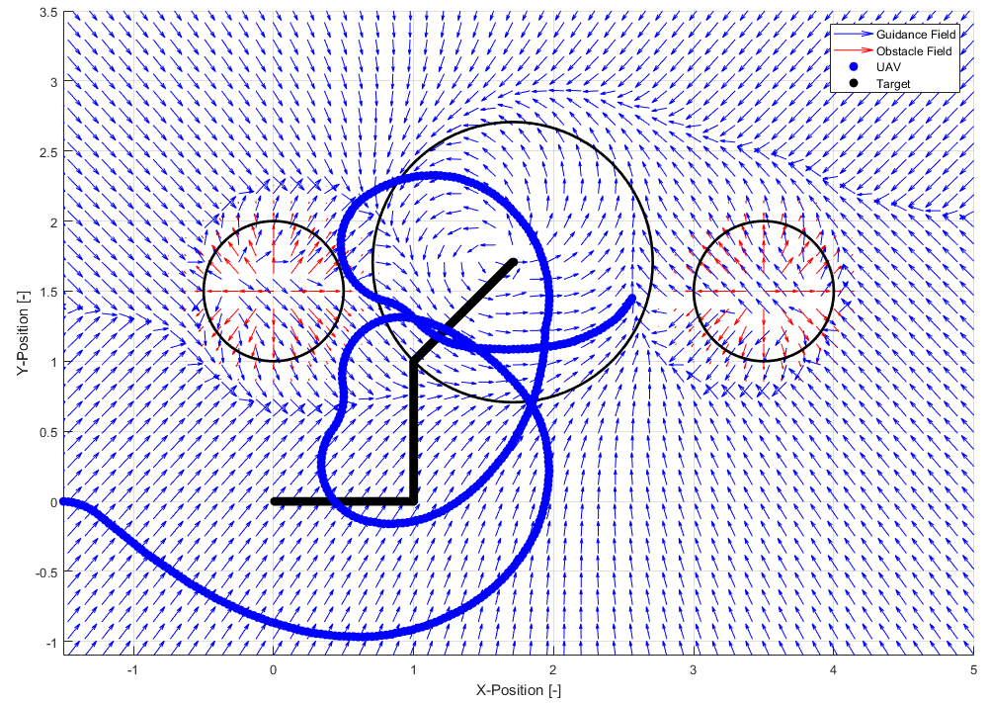
Literature Review
[Wilhelm, 2017]
Loiter moving target
Reduced steady-state error in comparison to Lyapunov
Obstacle Avoidance
Goal field tracked target ground vehicle
Repulsive fields representing obstacles
Fields summed resulting in guidance
Did not consider circulation to improve obstacle avoidance
Did not address singularities
GVF and Lyapunov tracking a ground target [Wilhelm]
UAV tracking a ground target and avoiding obstacles [Wilhelm]
Notes:
Wilhelm et al. attached a circular gradient vector field to a moving ground target resulting in a low tracking error loiter
In comparison to lyapunov vector fields by [NAME]
Obstacles were added to the simulation by placing a vector field with a negative convergence near the vehicles path
Summing together attractive loiter field and obstacle field produced a heading guidance which loitered the vehicle while avoiding obstacles
Obstacle fields only considered repulsive vectors and had zero circulation.
Summing vector fields could produce singularities where guidance vanishes (or singularity)
Discuss the three phases:

Slide 10
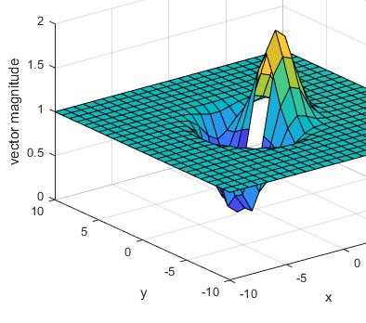
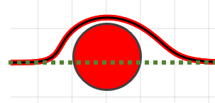
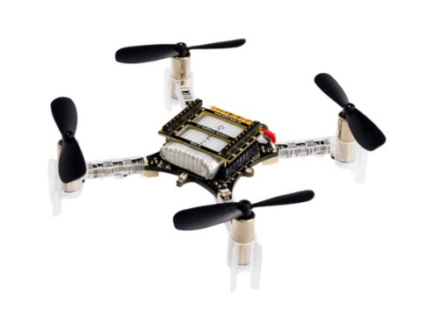
Methodology Overview
Phase I:
Objective: Characterize and present a method for locating singularities in a summed GVF
Construct field from literature
Evaluate scenarios where singularities are expected
Characterize location of singularities
Phase II:
Objective: Determine a combination of circulation and decay radius for circular obstacle GVF for optimized avoidance
Define obstacles in terms of UAV radius
Determine radius and circulation for optimized avoidance
Phase III:
Objective: Demonstrate optimized GVF guidance on multirotor UAV flying with turn rate constraints
Build quadcopter and modify for external commands
Program optimized guidance and control framework
Conduct flight tests and compare to simulations
Summed GVF magnitude surface with singularity
Optimized avoidance path
Crazyflie quadcopter

Slide 11
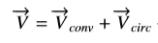
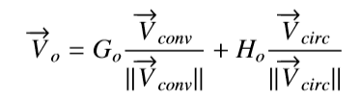
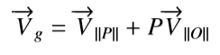
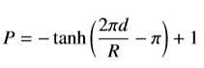
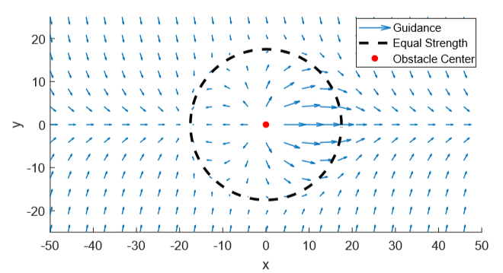
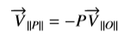
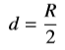
Phase I: GVF singularity detection
Objective: Characterize and present a method for locating singularities in a summed GVF
Construct path following and obstacle fields
Sum fields and weight repulsive field
Determine radius where fields have equal strength
Observe vector lengths in summed field
Singularities expected on radius of equal strength
Guidance
Singularity Condition
Path following and avoidance fields summed

Slide 12
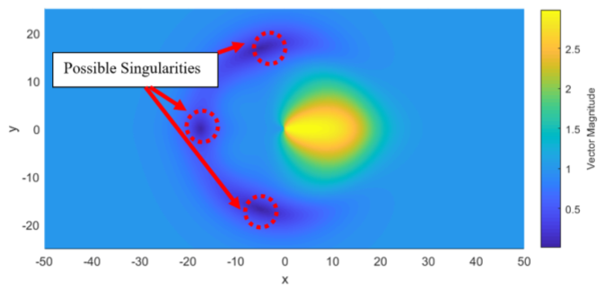
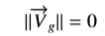
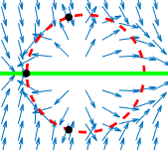
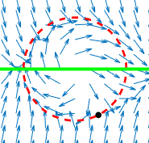
Phase I: GVF singularity detection continued
Objective: Characterize and present a method for locating singularities in a summed GVF
Two methods for locating singularities in a summed GVF
1) Brute force, evaluate region around obstacle and identify any minimums
2) Numerically search for singularity with initial conditions placed on radius of equal strength
Adding circulation to field removes singularities from UAVs route
Circulation removes directly opposing vectors that cancel
Heat map of summed field vector magnitudes
Singularities in field without circulation
Singularities in field with circulation

Slide 13
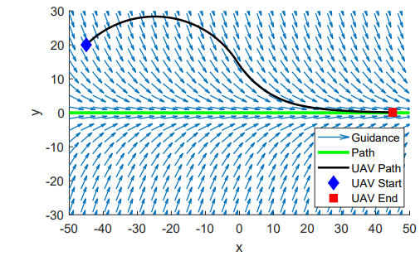
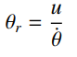
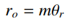
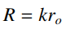
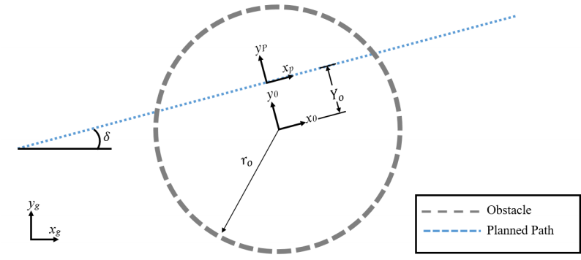
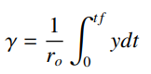
Phase II: Obstacle field optimization
UAV turning radius
Objective: Determine a combination of circulation and decay radius for circular obstacle GVF for optimized avoidance
Demonstrate Dubin’s vehicle simulating fixed wing UAV guided by GVF
Path following field circulation
Define obstacle in terms of UAV turning radius
Cost function to measure path deviation
Demonstrate avoidance for strictly repulsive GVF centered on path
Obstacle Definition
UAV route – guided to path with GVF guidance
Avoidance Cost
Circular obstacle along a planned path

Slide 14
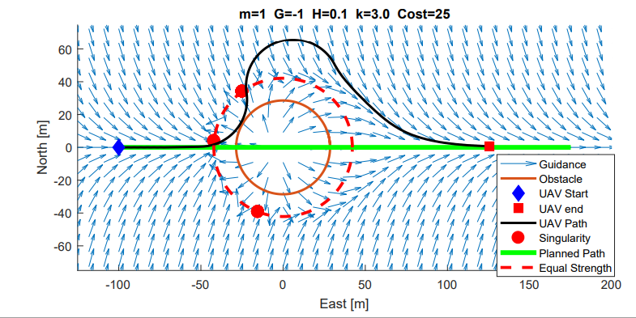
Phase II: Obstacle field optimization
Objective: Determine a combination of circulation and decay radius for circular obstacle GVF for optimized avoidance
Worst case head on collision scenario
Strictly repulsive field
Iteratively increased k until avoidance was achieved
Singularities along path
Excess path deviation
Unnecessary turns
Slow return to planned path
UAV route – guided by GVF guidance with obstacle on path

Slide 15
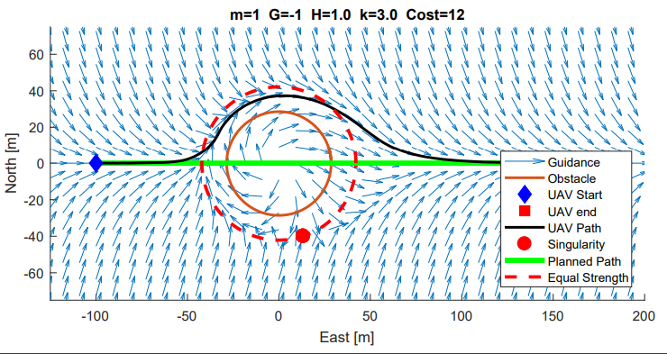
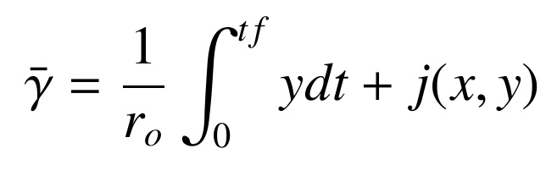



Phase II: Obstacle field optimization
Equal magnitude convergence an circulation. Decay radius, k, increased until avoidance achieved
G = -1, H = 1
Dead reckoning
UAV route when guided by equal magnitude field
Path deviation cost function
Penalize when inside obstacle
Optimized
Determine H,k that minimizes cost
UAV route when guided by optimized GVF

Slide 16



Phase III: Implement GVF on crazyflie
Objective: Demonstrate optimized GVF guidance on multirotor UAV flying with turn rate constraints
Program optimized GVF guidance and PID controllers in python
Validate python and MATLAB identical
Compare simulation and experimental flight costs
Experimental Setup
GVF
Position Controller
Navigation, Guidance, and Control

Slide 17


Results: Phase I & II, small obstacle
Objectives
Phase I: Determine a combination of circulation and decay radius for circular obstacle GVF for optimized avoidance
Phase II: Characterize and present a method for locating singularities in a summed GVF
Four scenarios evaluated
Centered, off centered
Small radius, large radius
Centered small radius obstacle
Off-centered small radius obstacle

Slide 18


Results: Phase I & II, large obstacle
Objectives
Phase I: Determine a combination of circulation and decay radius for circular obstacle GVF for optimized avoidance
Phase II: Characterize and present a method for locating singularities in a summed GVF
Four scenarios evaluated
Centered, off centered
Small radius, large radius
Centered large radius obstacle
Off-centered large radius obstacle

Slide 19



Results: Phase I & II Performance Summary

Slide 20


Results: Phase III
Objective: Demonstrate optimized GVF guidance on multirotor UAV flying with turn rate constraints
Compare experimental cost and simulation cost for 4 scenarios
Centered
Off centered
Small radius
m=1.5 radius
Experimental space
Experimental scenarios evaluated

Slide 21




Results: Phase III
Experimental route versus simulation route
PID response during experiment
Cost comparison between simulation and experiment
Experimental UAV speed

Slide 22

Results: Phase III
Experimental route versus simulation route

Slide 23

Results: Phase III
Experimental route versus simulation route

Slide 24

Results: Phase III
Experimental route versus simulation route

Slide 25

Results Summary
Phase I:
Objective: Characterize and present a method for locating singularities in a summed GVF
Phase II:
Objective: Determine a combination of circulation and decay radius for circular obstacle GVF for optimized avoidance
Phase III:
Objective: Demonstrate optimized GVF guidance on multirotor UAV flying with turn rate constraints
Singularities in summed fields with and without circulation
Optimized avoidance in simulation
Optimized avoidance in experimentation

Slide 26
Conclusions
Singularities in GVF can be found by searching for zero vector lengths numerically with equal strength initial conditions
Circulation removes singularities from path preventing tap situation and null guidance
Decay radius R and circulation H may be optimized for avoidance by minimizing path deviation cost function
Optimized GVF performs similar to waypoint and better than unmodified GVF or VFF
GVF can be implemented for real time guidance, as demonstrated with multirotor flight experiments
Successful avoidance

Slide 27
Thanks
Questions?

Slide 28
Appendix
Cosine law for GVF
Look-ahead-flight envelope

